Slide 1

SoECE
Operating system and
Embedded system Design
Students Details:
Sl. No | Name | USN
1. | Murari | 01FE20BEC084
2. | Anand Doddamani | 01FE20BEC102
3. | Nitish D Kulkarni | 01FE20BEC111
4. | D S Sanjaya | 01FE20BEC115
Under the Guidance of:
Prof. Rohini Hongal

Slide 2
SoECE
Contents:
Introduction
Problem Statement
What is SPI?
4) How SPI works?
5) Connection between master and slave?
6) Proteus
7) Code Analysis
8)Conclusion

Slide 3
SoECE
Introduction
In this project our main focus is on two things that is SPI and EEPROM.
SPI stands for Serial Peripheral Interface which is used for short-distance communication.
SPI can be related to the I2C protocol which is based on the master and slave concept.
It can communicate with its peripherals as well as with another microcontroller depending upon the requirement.
This provides full-duplex communication at faster rates/ speeds.
EEPROM (electrically erasable programmable read-only memory) is a user-modifiable ROM
It can be erased and reprogrammed (written to) repeatedly by applying an electrical voltage that is higher than normal.
It is the memory part of the microcontroller with which we can interface.

Slide 4
SoECE
Problem statement:-
Use SPI to register occurrence of interrupt count value on EEPROM and display same thing on using serial protocol and perform the code analysis.

Slide 5
SoECE
What is SPI?
Serial Peripheral Interface or SPI is a synchronous serial communication protocol that provides full-duplex communication at very high speeds. Serial Peripheral Interface (SPI) is a master-slave type protocol that provides a simple and low-cost interface between a microcontroller and its peripherals.
SPI Interface bus is commonly used for interfacing microprocessor or microcontroller with a memory like EEPROM, RTC (Real Time Clock), ADC , DAC (Digital – to – Analog Converters), displays like LCDs, Audio ICs, sensors like temperature and pressure.
UART uses synchronization bits i.e. Start bits and Stop bits. If the baud rates of the transmitter and receiver are not matched, the data sent from the transmitter will not reach the receiver properly and often garbage or junk values are received.
SPI is a Synchronous type of serial communication i.e. it uses a dedicated clock signal to synchronize the transmitter and receiver.

Slide 6
SoECE
How SPI works?
In SPI protocol, the devices are connected in a Master – Slave relationship in a multi – point interface. In this type of interface, one device is considered the Master of the bus (usually a Microcontroller) and all the other devices (peripheral ICs or even other Microcontrollers) are considered as slaves.
In SPI protocol, there can be only one master but many slave devices.
The SPI bus consists of 4 signals or pins. They are
Master–Out / Slave–In (MOSI)
Master–In / Slave–Out (MISO)
Serial Clock (SCLK) and
Chip Select (CS) or Slave Select (SS)

Slide 7
SoECE
How SPI works?
Master – Out / Slave – In or MOSI:
It is the data generated by the Master and received by the Slave. Hence, MOSI pins on both the master and slave are connected together.
Master – In / Slave – Out or MISO:
It is the data generated by the Slave and must be transmitted to the Master.

Slide 8
SoECE
How SPI works?
Since the clock is generated by the Master, the flow of data is controlled by the master. For every clock cycle, one bit of data is transmitted from master to slave and one bit of data is transmitted from slave to master.
This process happens simultaneously and after 8 clock cycles, a byte of data is transmitted in both directions hence, SPI is a full – duplex communication.
If the data has to be transmitted by only one device, then the other device has to send something (even garbage or junk data) and it is up to the device whether the transmitted data is actual data or not.
This means that for every bit transmitted by one device, the other device has to send one-bit data i.e. the Master simultaneously transmits data on the MOSI line and receive data from the slave on the MISO line.

Slide 9
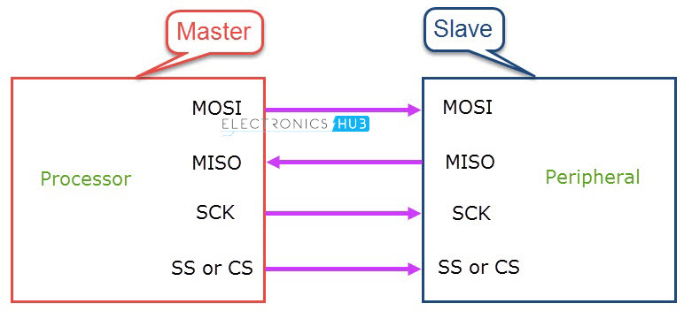
SoECE
How The connection between a Master and a Slave

Slide 10
SoECE
Advantages of SPI:
SPI is very simple to implement and the hardware requirements are not that complex.
Supports full-duplex communication at all times.
Very high speed of data transfer.
No need for individual addresses for slaves as CS or SS is used.
Only one master device is supported and hence there is no chance of conflicts.
Clock from the master is configured based on the speed of the slave and hence slave doesn’t have to worry about the clock.

Slide 11
SoECE
Disadvantages of SPI:
Slowest device determines the speed of transfer.
There are no official standards and hence often used in application-specific implementations.
There is no flow control.
Each additional slave requires an additional dedicated pin on the master for CS or SS.

Slide 12
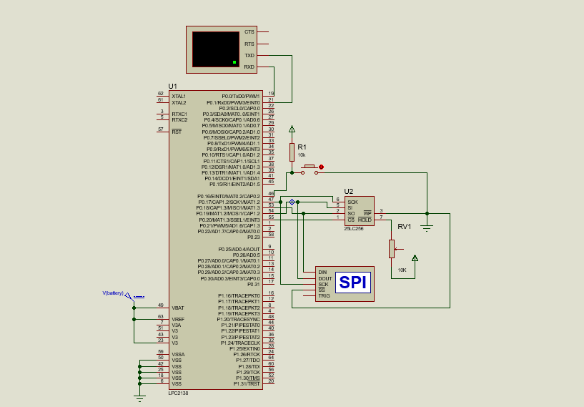
SoECE
Proteus Simulation

Slide 13
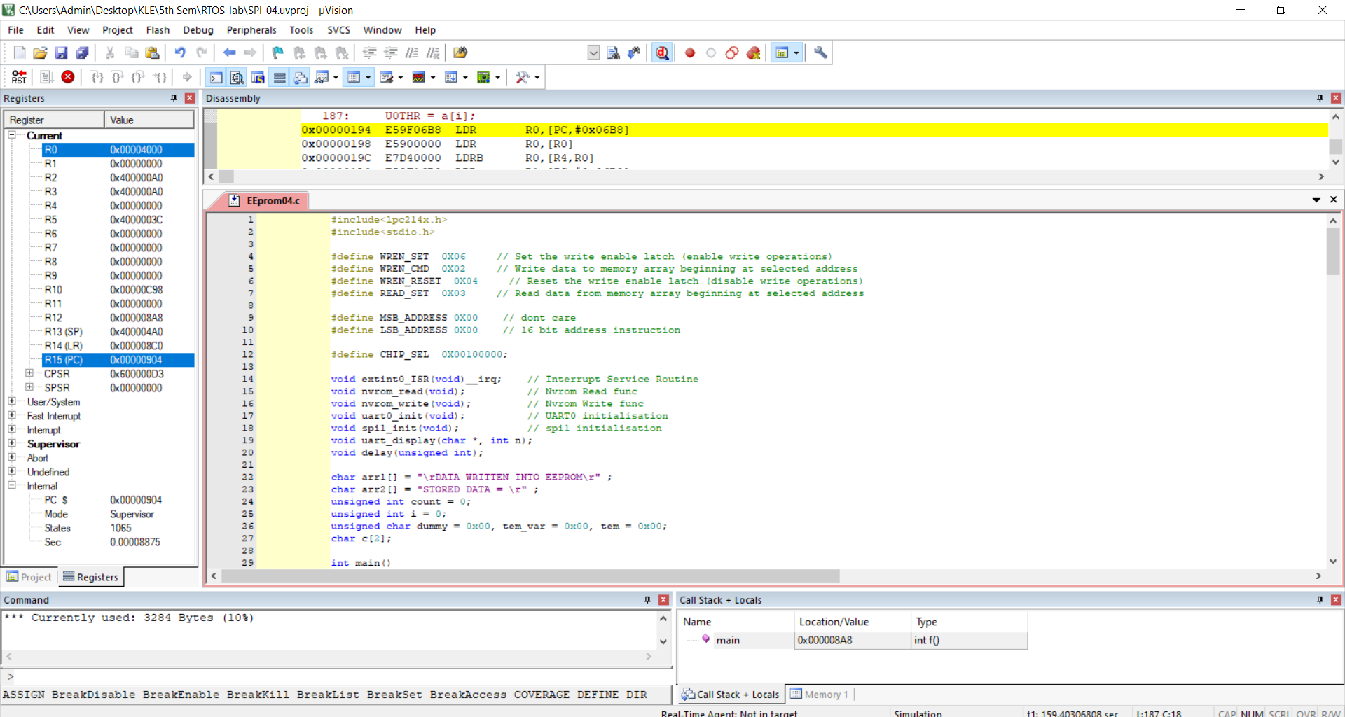
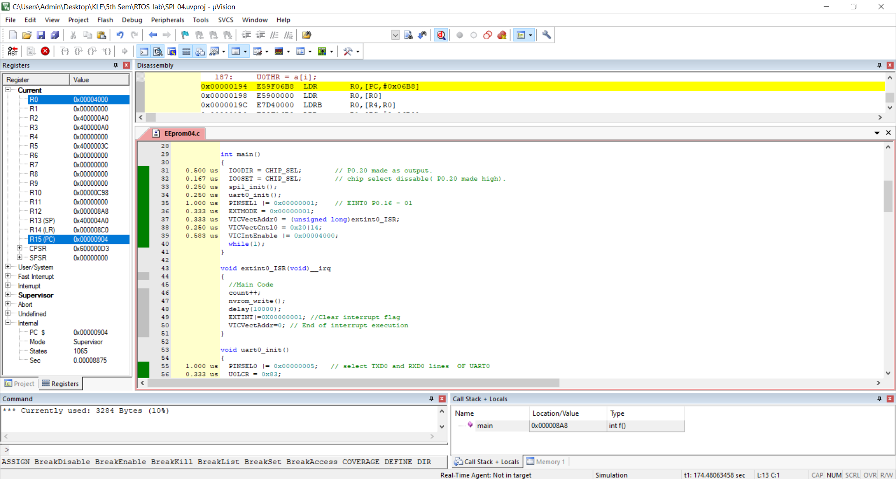
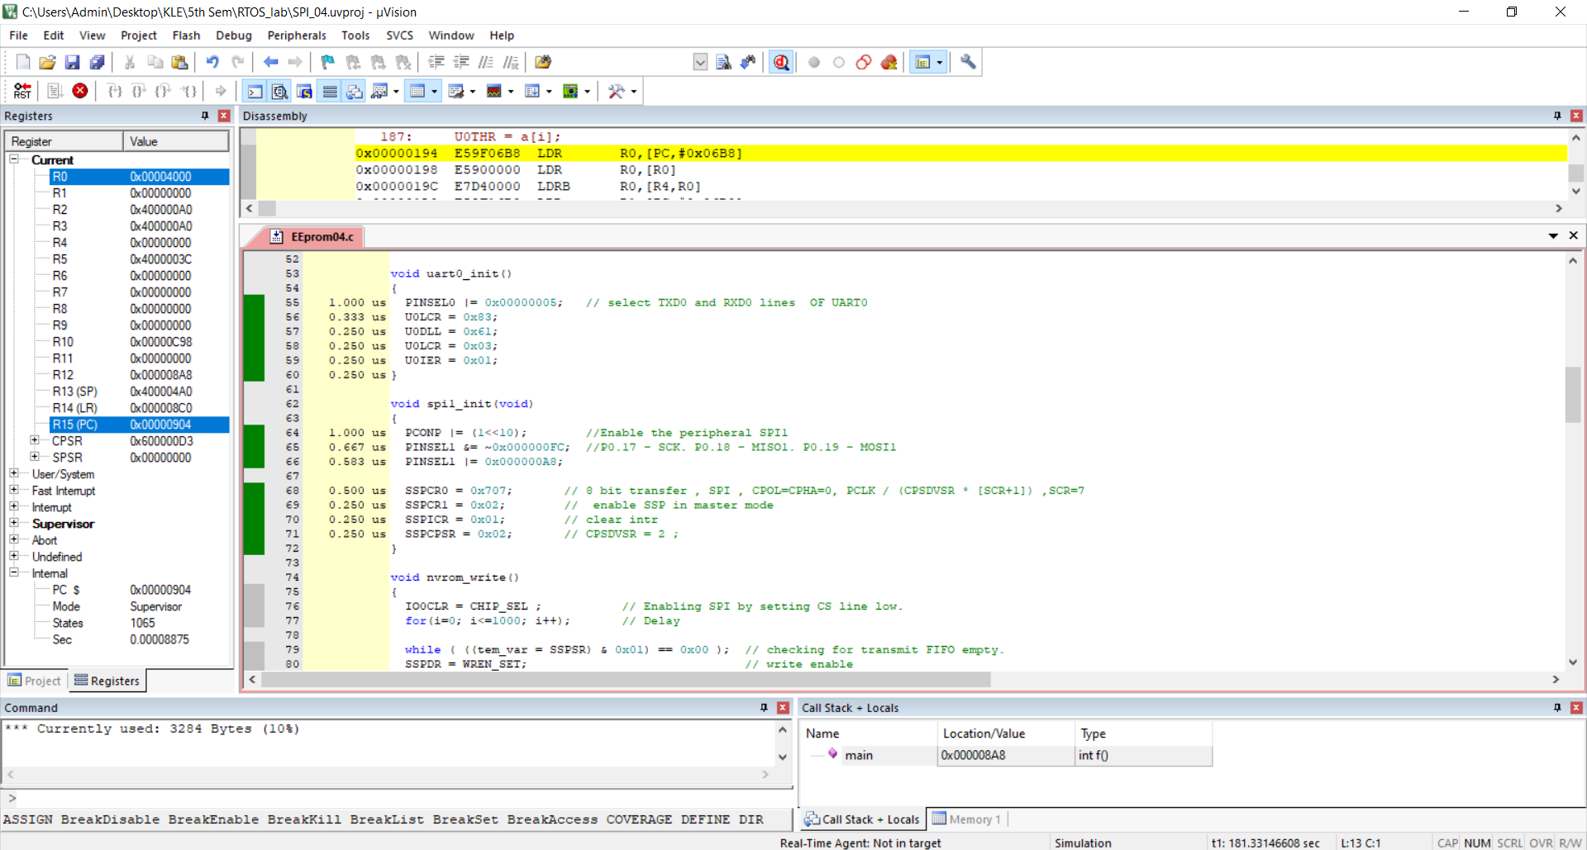
SoECE
Code Analysis:
Time Analysis: 9.499 u Secs
Memory Analysis: 3284 bytes

